Slide 1

Collaborative Project
976860W

Slide 2
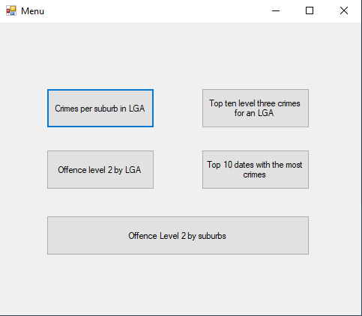

Presentation
Notes:
This is the final product of what the development team has been requested to build from you. The final product includes the five features that you described to us for sorting the crime statistic csv file. In this presentation I will be explaining the effectiveness of the two features I built within this project and the process I took in designing the features to your expectations.

Slide 3
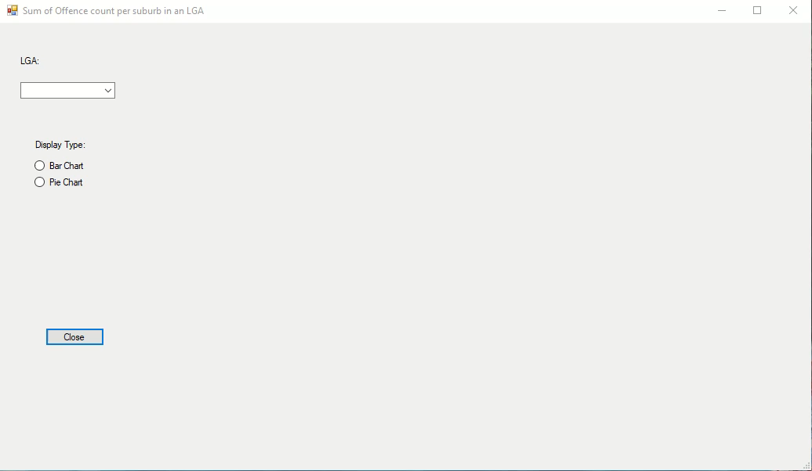
First Feature
Notes:
A feature you requested for our development team to create was being able to visualize the overall crime count for each suburb and LGA in different formats. After showing the initial feature you changed what you wanted the feature to do. The new feature would display the crime count for each suburb in a selected LGA. With the loading of the form, you are given an option to select an LGA from a combo box item list. The LGA includes multiple suburbs which all have their own crime count. This feature would display the number of crimes for each suburb registered under the LGA in either a column chart or pie chart depending on what display type is selected.
This feature will allow for the police to see what suburbs within an LGA is more likely to have a crime reported giving the police information on where a future police station can be built or where there should be an increased number of police officers to decrease the crime rate. The pie chart includes a percentage value for the number of crimes in a suburb for the overall number of crimes reported in the LGA allowing for easier reading of the data for what the probability a crime occurs in a specific suburb throughout a year compared to other suburbs in the LGA.
An example includes that the percent of crimes for Gawler South is greater than the percentage of crimes in Gawler East showing that there is greater number of crimes which occur in Gawler South then Gawler East and Gawler South should therefore have more police officers.

Slide 4
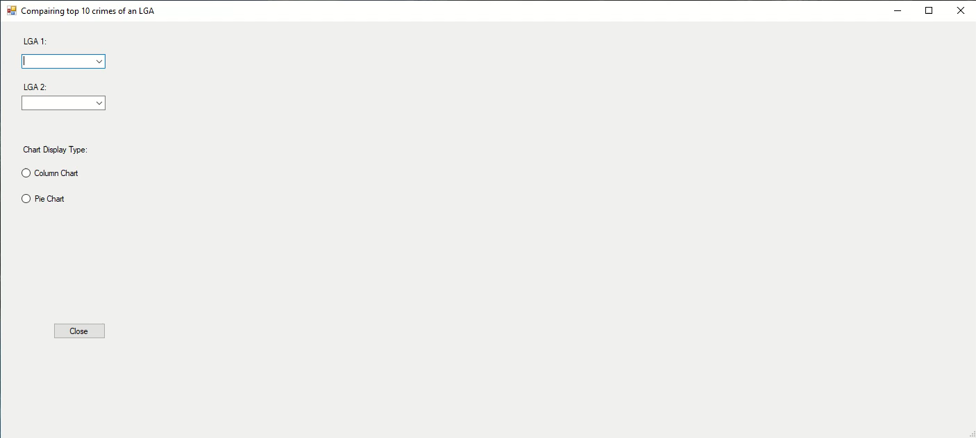
Second Feature
Notes:
Another feature that you have requested is to compare the top ten level three crimes for two different selected LGA’s. Where each LGA’s top ten crimes is calculate from the top 10 highest offence counts per offence type. The displaying of the data can be selected as a pie chart of column chart. The column chart allows for the exact number of offence count per offence type to be displayed, where the pie chart has the percentage of offence count for each type of offence type.
The feature will allow for police to check on what crimes are more likely to happen per LGA. This can help with the police knowing what actions to take in making the LGA a safer environment and decrease the number of crimes that occur. The information can also help not only the police but others inside that LGA with knowing how to prevent offences occurring to them. With the feature of comparing the top 10 offence types per LGA’s it can help with organizing what area a specialist of a specific offence type should focus on leading to crimes being solved more efficiently.
An example of this feature is that the graffiti offence from Adelaide hills is in the top ten offence types for Adelaide hills but in Adelaide the graffiti offence is not on the top ten offence type chart indicating that graffiti does not happen as often in Adelaide compared to how often in Adelaide hills it occurs.

Slide 5
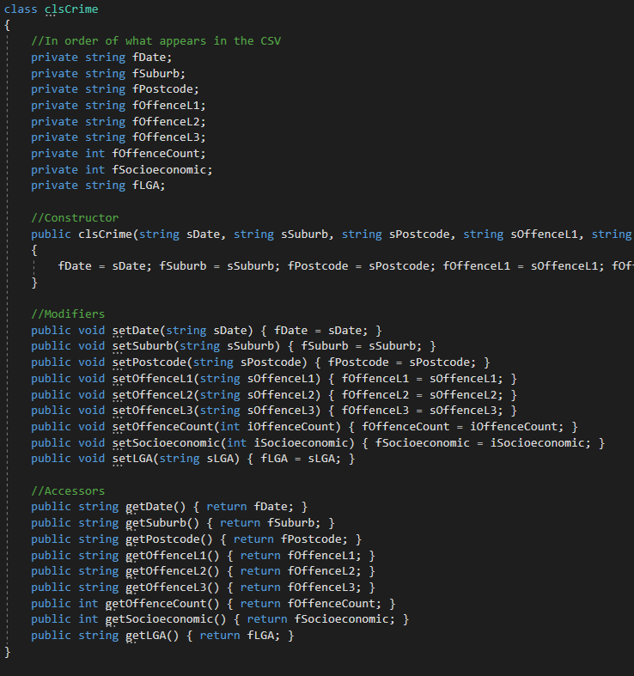
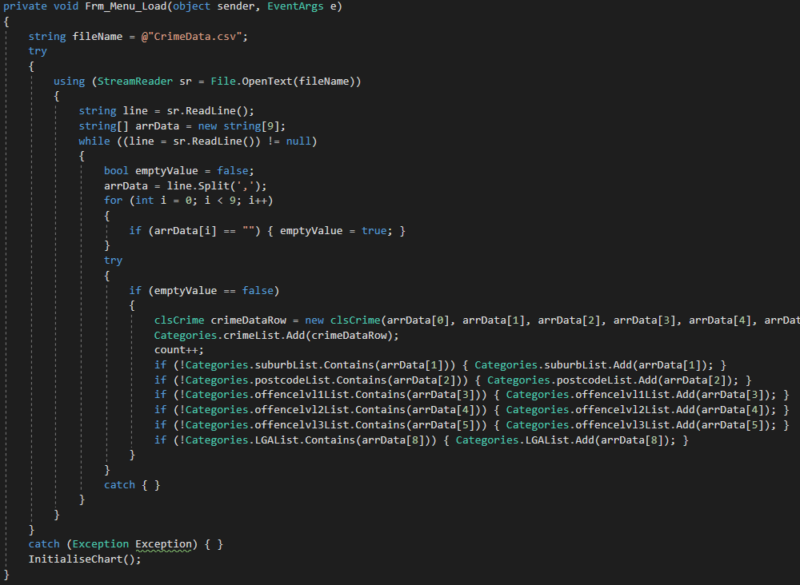
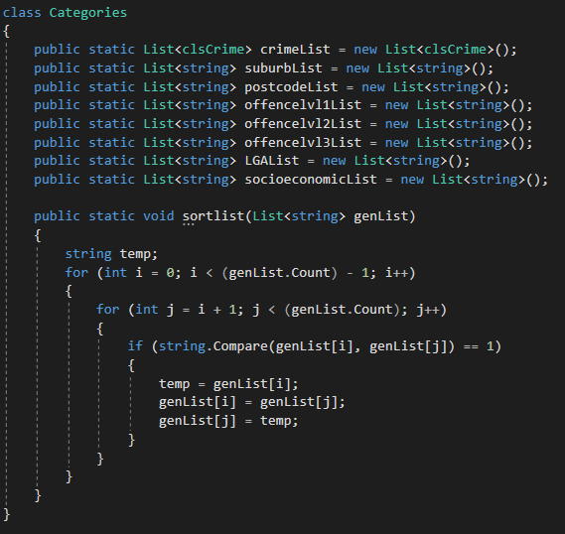
Project
Notes:
For this assessment, a group of 3 developers including myself have created a project which reads information from a csv file and stores the information inside an object allowing for meaningful name to values. The object can be used to store values that are of different types of variables such as strings and integers, this allows for the storing of all values in the row of the csv file. The values inside the object can only be changed by calling the modifier function limiting the chance of accidental value change in the object. The project consisted of six features for sorting the data, hopefully creating an easy solution for police to view the crime data over Adelaide in 2020. With the use of data visualization in visual studio, the data can be displayed in a more visualizing manor instead of a data grid view. Different types of data visualization include a pie chart, bar chart, and line chart. With the use of classes, each category from the csv file gets added to its own list inside a class which can be accessed from all features in the project. Although the class requires more space in memory and the process of storing data is slower, it allows for the access of values inside the class from the entire project.

Slide 6
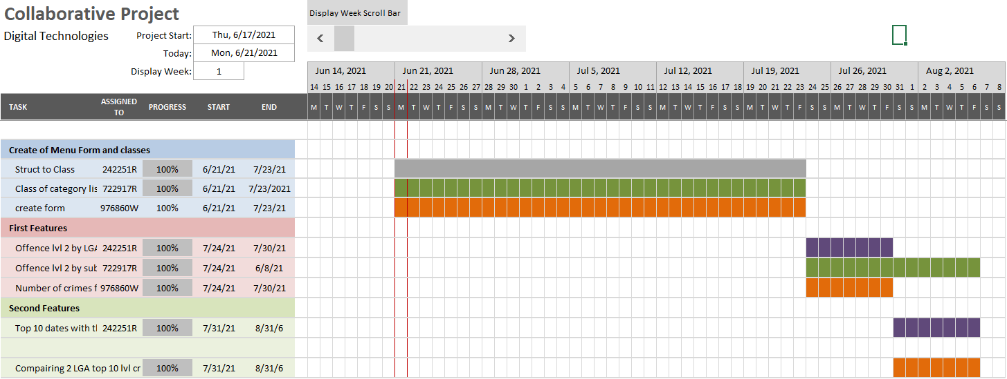
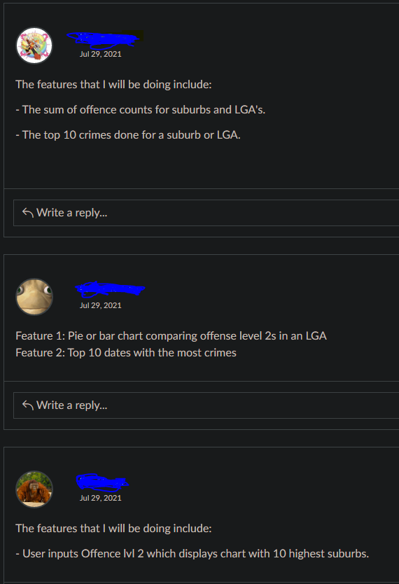
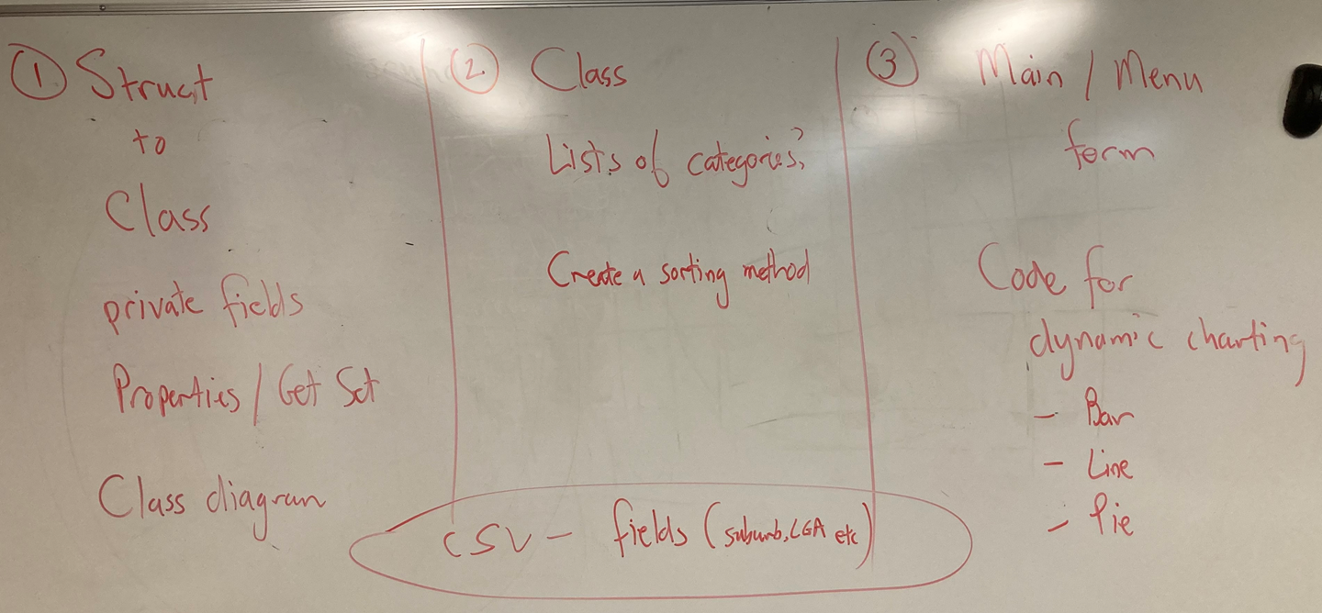
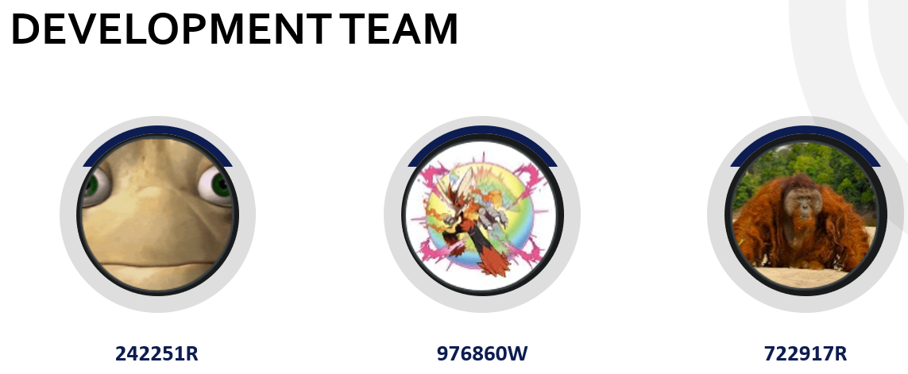
Collaborative project work process
Notes:
This project was large and needed to be worked on by multiple people to finish it by the required completion date. The initial project was split into three parts after discussing all parts, one for each group member. The first task was converting the struct of values obtained from the csv to a class with the inclusion of accessors, modifiers and a constructor. The second task was adding all the different types of category values from the csv into separate category lists which are all held inside a class. This class also included a sorting function to sort the lists of categories if needed. The third task was creating the main menu form which is used to show all features the user can use. The third task involved the collection of data from the csv file and storing of values into classes imported from other members. The creation of three different charts was also apart of the third task.
After discussing with the group members what task everyone would prefer, I was given the third task which involved the combining of all group members tasks in the end.
After the completion of the initial project, the group were given six different features to add to the project. As a group, we decided on what feature we would select and added it our chosen features to the discussion board on canvas which we can all look at and type into. This made it so no one did the same features and so that everyone could remember their features. The two features I chose were displaying the crime counts of the suburbs inside an LGA and the comparing of the top ten crimes for two different LGA’s. Using a grant chart, the group members displayed the progress and time spent on their features and initial project development allowing the group members to see what part the other group members are up to.

Slide 7
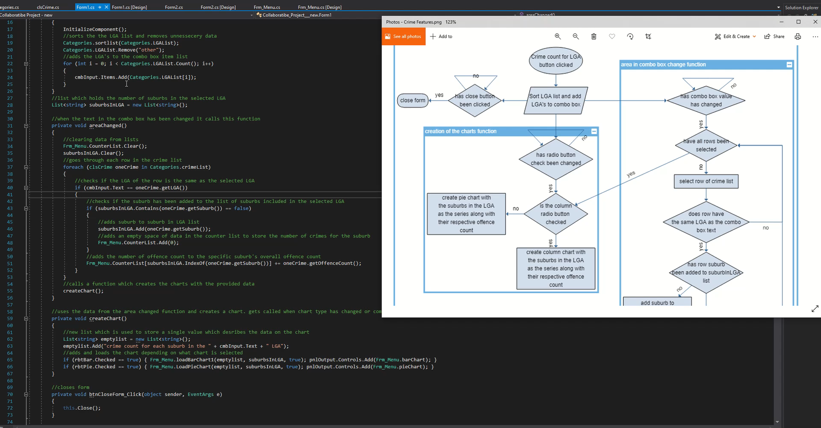
First Feature

Slide 8
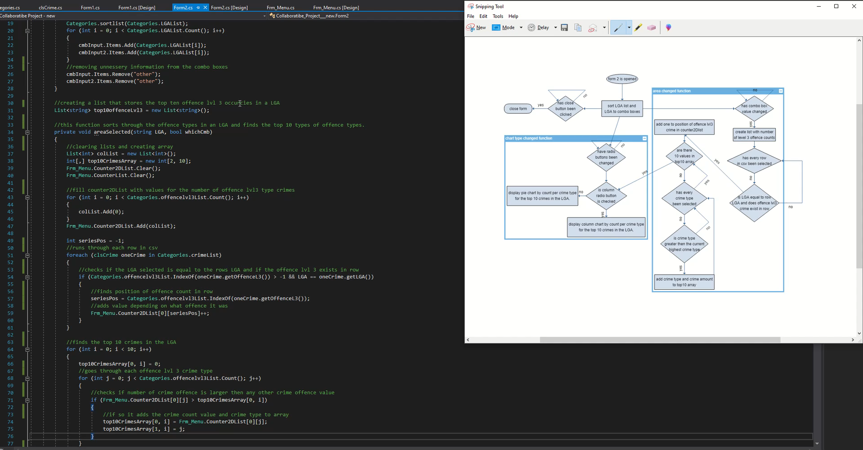
Second Feature

